Slide 1
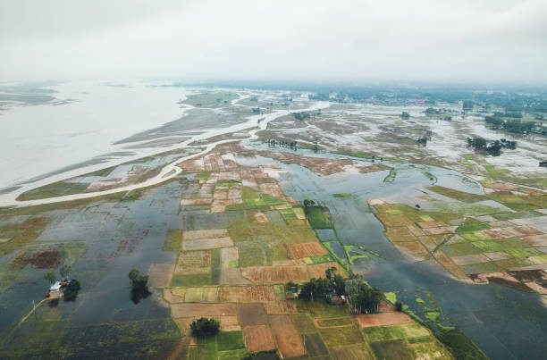

Prediction of Flash Flood Susceptible Zone using Machine Learning and Advanced Geospatial Techniques in parts of Teesta Basin, India
Prepared & Presented by
Moslem Miah
Roll: VU/PG/22/34/02-IVS-0014
Registration No. VP221000161 of 2022-2023
Under the Supervision of
Dr. Dipanwita K. Dutta
Assistant Professor
Department of Remote Sensing and GIS
Vidyasagar University
Paschim Mednipur, 721102
Date – 09/07/2024

Slide 2
Introduction
Flash floods are fast and unexpected flood events that can happen within an hour of heavy rainfall, dam breaks, or other causes.
Understanding and predicting areas prone to flash floods is crucial for minimizing the adverse effects on communities and ecosystems.
Remote sensing is a valuable method for monitoring and analyzing environmental factors across large areas, offering wide coverage, high-resolution data, and multi-spectral information.
Machine learning (ML) techniques offer powerful tools for analyzing complex datasets and improving predictive accuracy.

Slide 3
Aim & Objectives
The aim of the study is to prediction of flash flood susceptibility zone using ML and advanced geospatial techniques in Teesta basin, India.
The major objectives of the study are –
Objective 1: To identify and analyze the key physical, environmental, and anthropogenic factors that contribute to the occurrence of flash floods in the Teesta Basin, India.
Objective 2: To develop and validate a machine learning-based flash flood susceptibility model using the identified contributing factors and advanced geospatial techniques

Slide 4
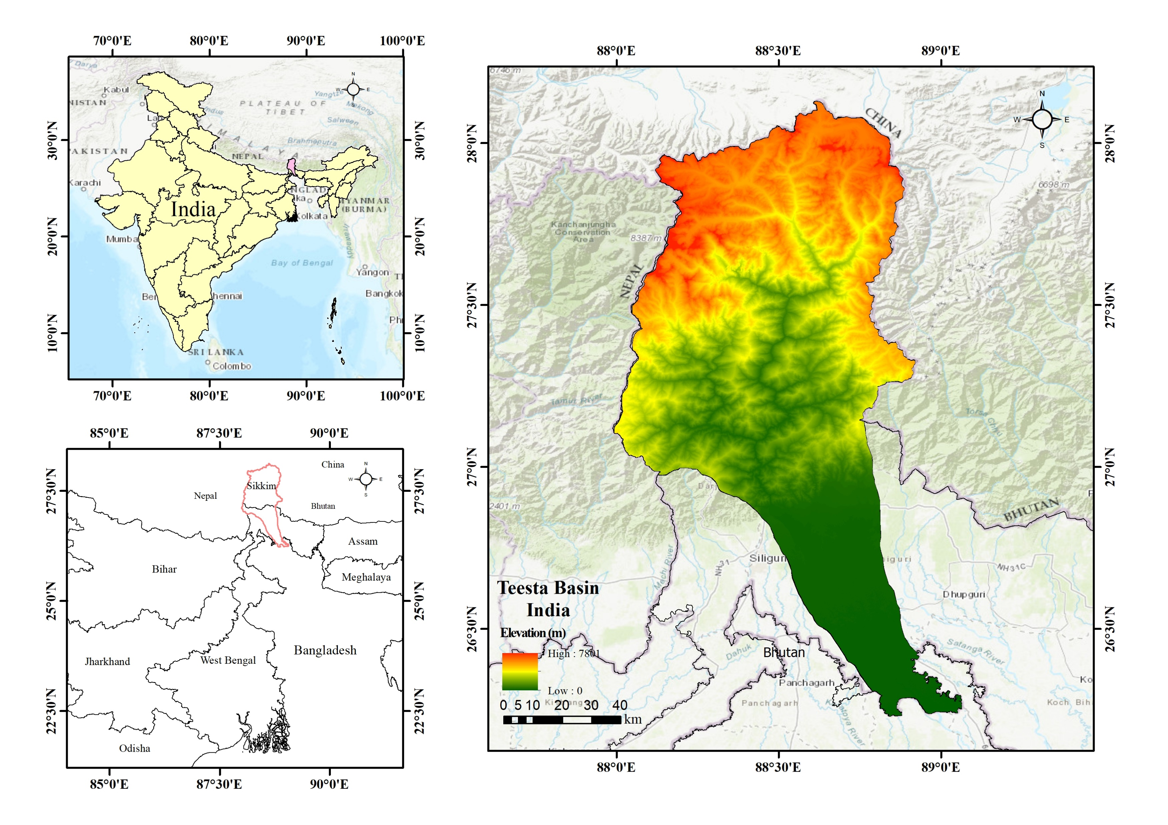
Study Area
This study area is situated between latitudes 26°13'49.97“ N and 28°7'39.93“ N, and longitudes 87°59'30.85“ E and 89°3'48.08" E.
Area coverage: 9,855 sq. km.
Elevation: 0 – 7800 m
Major river: Teesta

Slide 5
Datasets
Data | Resolution | Source | Acquisition Date
Sentinel – 1 | 10 m | GEE Data Catalog | Before flood: 27/09/2023-03/10/2023 After flood: 04/10/2023-11/10/2023
Sentinel – 2 | 10 | GEE Data Catalog | 01/09/2023-30/09/2023
ALOS PALSAR DEM | 12.5 m | Alaska Satellite Facility | 2006 - 2011
CHIRPS | 5.5 km. | GEE Data Catalog | 27/09/2024-04/10/2024
Software & Platform used:
ArcGIS, ArcGIS Pro, QGIS, Google Earth Pro, Google Earth Engine, Jupyter Notebook (Python)

Slide 6
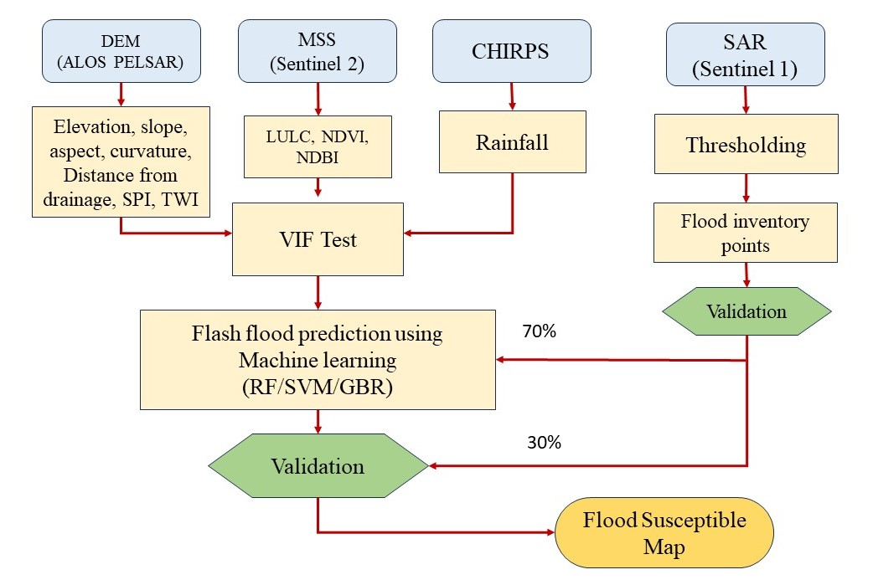
Methodology

Slide 7
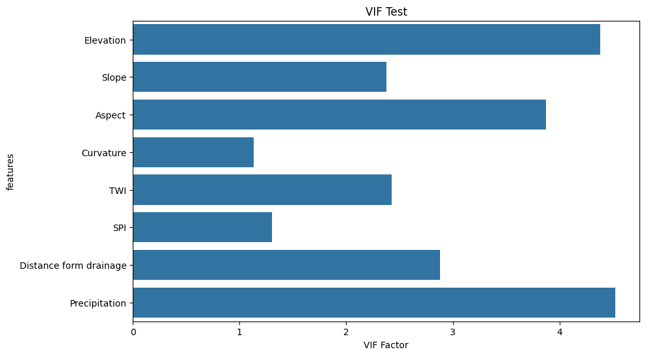
Influencing Factors
The study began by selecting numerous factors based on a review of previous literature and data availability.
After conducting a multicollinearity test (VIF), eight factors were chosen for the study: Elevation, Slope, Aspect, Curvature, distance from river, Stream Power Index (SPI), Topographic Wetness Index (TWI), and Precipitation.

Slide 8
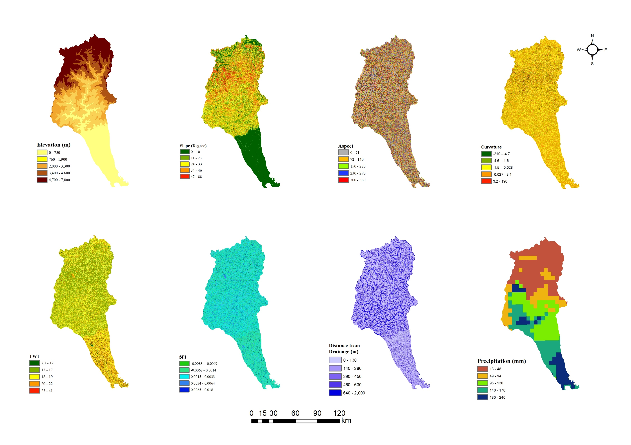
Influencing Factors

Slide 9
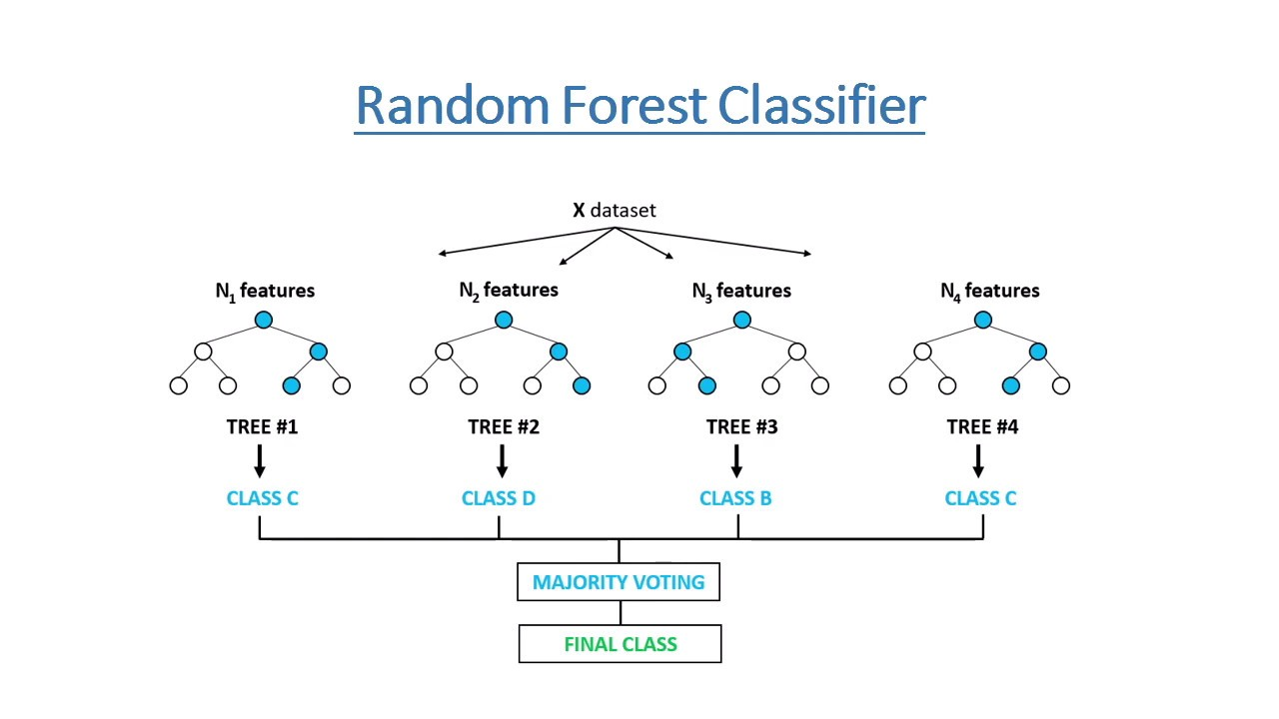
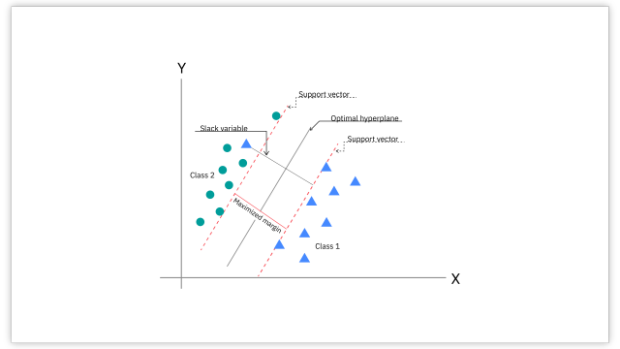
ML Model
Random Forest (RF) | Support Vector Machine (SVM) | Gradient Boosting Regression (GBR)
Ensemble learning method combining multiple decision trees. Reduces overfitting by introducing randomness in tree creation. Computationally expensive and consumes more memory. | Finds a hyperplane in high dimensional space that best separates target values. Effective for handling outliers. Computationally expensive for large datasets. | Creates a series of weak decision trees that improve on each other. Highly accurate for complex relationships in data. Prone to overfitting.
Support Vector Machine

Slide 10
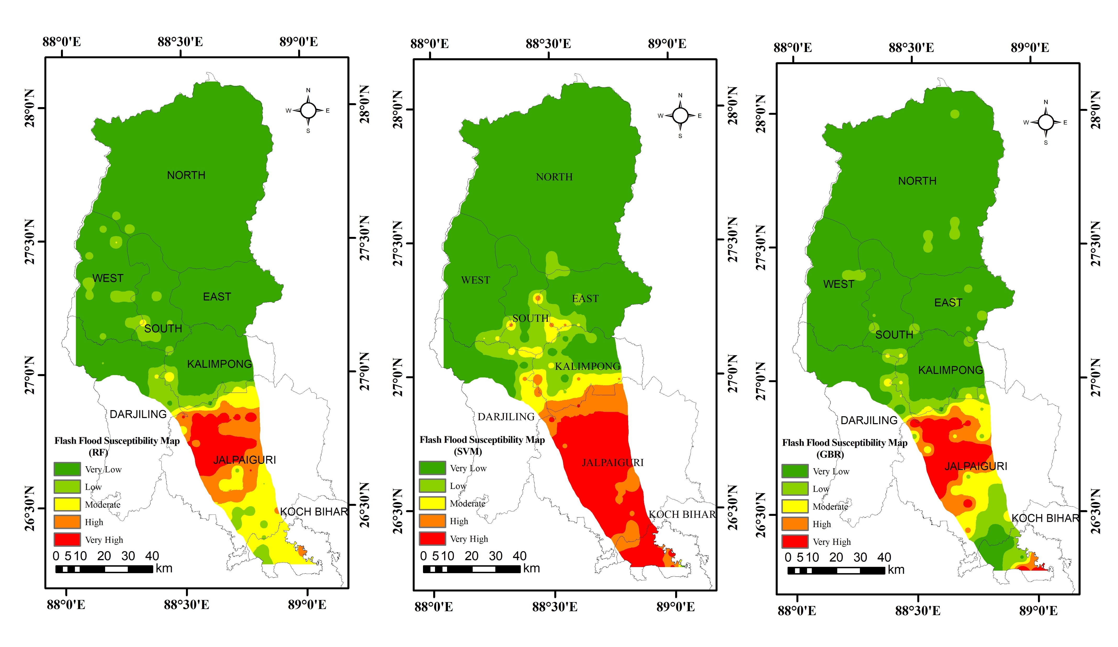
SVM
RF
Zone | Area (Sq.Km.) | Area (%)
Very low | 6699.63 | 67.98
Low | 853.07 | 8.66
Moderate | 413.17 | 4.19
High | 557.33 | 5.66
Very high | 1331.79 | 13.51
GBR
Zone | Area (Sq.Km.) | Area (%)
Very low | 7555.11 | 76.7
Low | 637.30 | 6.47
Moderate | 737.92 | 7.49
High | 512.37 | 5.2
Very high | 412.31 | 4.18
Zone | Area (Sq.Km.) | Area (%)
Very low | 7787.77 | 79.02
Low | 768.42 | 7.80
Moderate | 440.65 | 4.47
High | 359.06 | 3.64
Very high | 499.11 | 5.06

Slide 11
Comparison result of RF, SVM, & GBR model
RF
SVM
GBR
Zone | Area (Sq.Km.) | Area (%)
Very low | 7555.11 | 76.7
Low | 637.30 | 6.47
Moderate | 737.92 | 7.49
High | 512.37 | 5.2
Very high | 412.31 | 4.18
Zone | Area (Sq.Km.) | Area (%)
Very low | 6699.63 | 67.98
Low | 853.07 | 8.66
Moderate | 413.17 | 4.19
High | 557.33 | 5.66
Very high | 1331.79 | 13.51
Zone | Area (Sq.Km.) | Area (%)
Very low | 7787.77 | 79.02
Low | 768.42 | 7.80
Moderate | 440.65 | 4.47
High | 359.06 | 3.64
Very high | 499.11 | 5.06

Slide 12
Feature Importance
Features | Importances (RF) | Importances (GBR)
Elevation | 0.321499 | 0.734011
Precipitation | 0.262130 | 0.128763
Slope | 0.179428 | 0.054906
TWI | 0.072786 | 0.013103
SPI | 0.045124 | 0.029252
Aspect | 0.036723 | 0.009039
Curvature | 0.039202 | 0.016795
Distance from drainage | 0.043108 | 0.014132

Slide 13
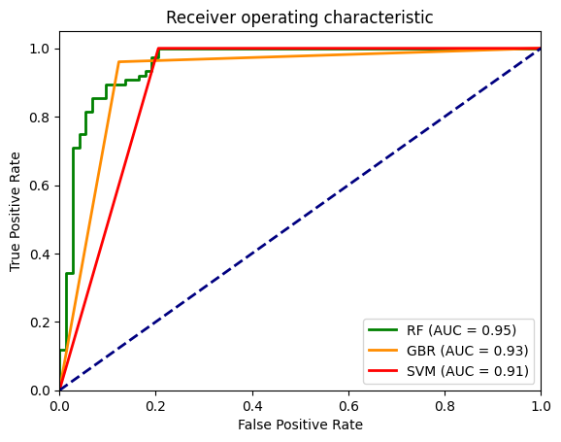
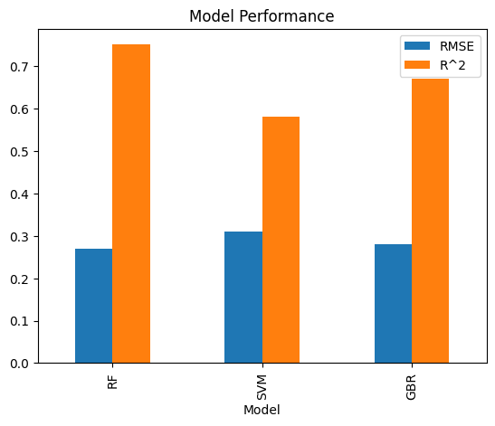
Model Performance
Model | Root Mean Squared Error (RMSE) | R² | Area Under Cover (AUC)
Random Forest (RF) | 0.27 | 0.75 | 0.95
Support Vector Machine (SVM) | 0.31 | 0.58 | 0.91
Gradient Boosting Regression | 0.28 | 0.67 | 0.93

Slide 14
Conclusion
The study successfully identified and analyzed the key physical, environmental, and anthropogenic factors contributing to flash floods in the Teesta basin.
The study successfully developed and validated a machine learning-based flash flood susceptibility model for the Teesta basin using the identified contributing factors and advanced geospatial techniques.
The model demonstrated high predictive accuracy and reliability in identifying areas prone to flash flood events, as validated through cross-validation and independent testing.
The flash flood susceptibility maps generated from the models can serve as a valuable tool for local authorities and decision-makers to prioritize flood-prone areas, implement targeted mitigation measures, and enhance disaster preparedness in the Teesta basin.

Slide 15
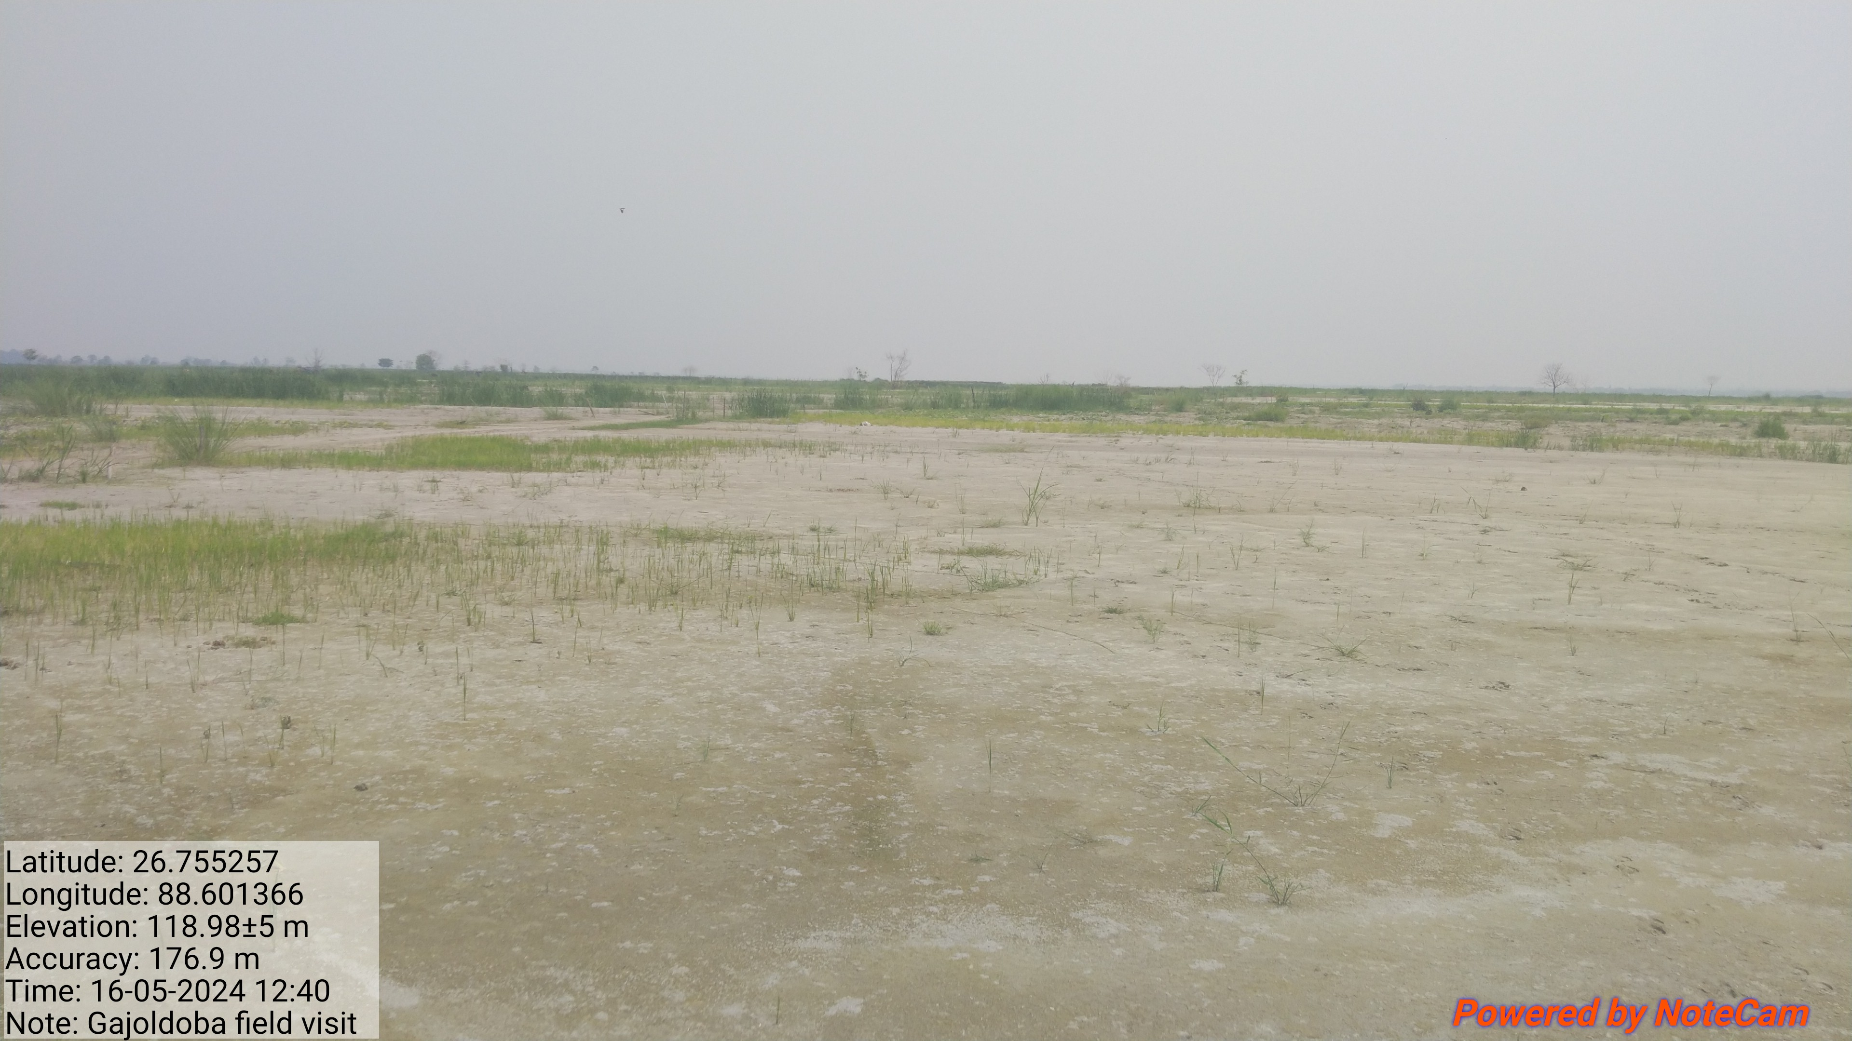
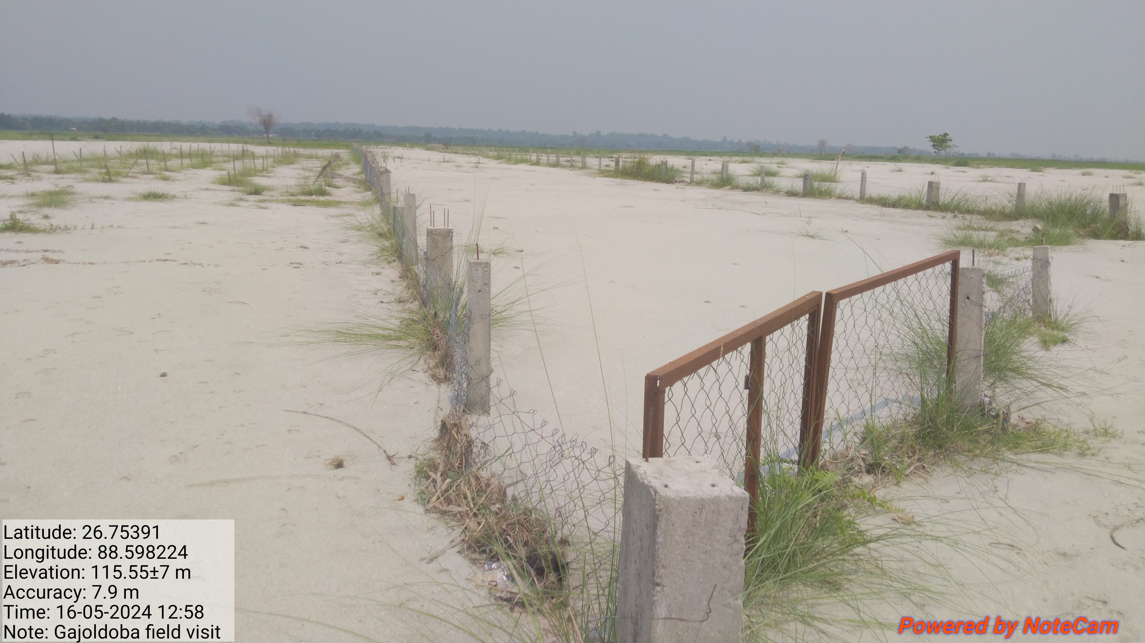
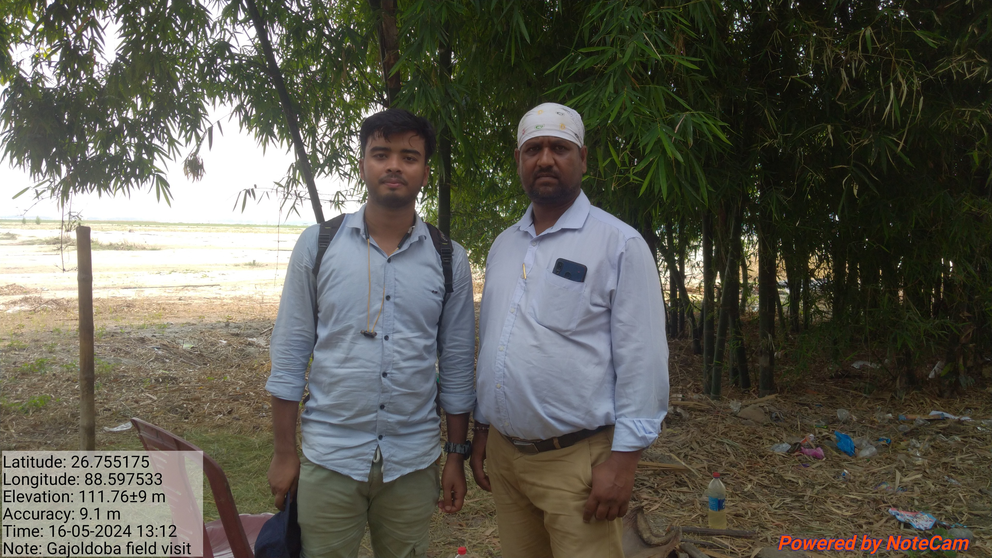
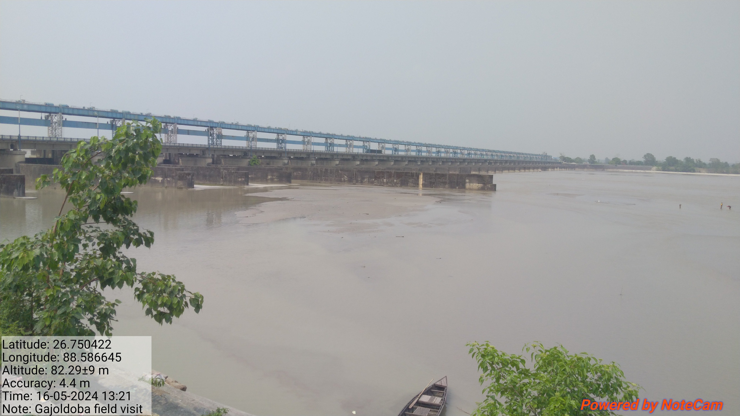
Field Photograph

Slide 16
Thank You

